Slide 1

Artificial Intelligence Awareness
Draft for discussion
Commission de surveillance du secteur financier (CSSF)
February 13th, 2019
AI General Awareness session
Confidential information only for training purpose (refer to disclaimer)

Slide 2
Table of contents
Introduction and Motivation
Why AI now?
Some headlines
The rise of AI & Machine Learning
History
Vocabulary and Key concepts
Recent developments & challenges
Building an auditing an AI
Building an AI
Auditing an AI
Auditing Use-case
What are the regulators doing?
Enablers for auditing
Human Resources
Technical Resources
An Ocean of technologies to support AI
Responsible and ethical AI
Responsible, robust and beneficial AI
Analytics operating models
Q & A

Slide 3
1
1
Introduction and Motivation

Slide 4
Table of contents
Introduction and Motivation
Why AI now?
Some headlines
The rise of AI & Machine Learning
Building an auditing an AI
Enablers for auditing
Responsible and ethical AI
Q & A

Slide 5

Why AI now?
Some key capabilities
Increase of AI Investment
Chatbots
Increase of complexity of environment
Virtual Assistants
Speech
(to text)
Image Recognition
Virtually Unlimited Computing Power
Natural Language processing
Neuronal Network
Improvements of HW / SW and Algorithms required for AI
Machine Learning
Robotics
Predictive analytics
Steep growth of data available
Deep Learning
Decrease of storage cost

Slide 6
A Huge Market opportunities for industries and AI solution providers
$153B
AI solutions
revenue
Opportunity by 2020
$14T-$33T in
Annual economic
impact by 2025*
$0.6T- $0.8T economic impact in Financial Sector
A booming AI
Investment Market reaching $2.5B
GDP in 2016: US $19,4T, China $11,5T, France $2,4T

Slide 7
Where are we and where are we aiming?
Artificial Intelligence is moving from assisted intelligence to augmented intelligence
Assisted Intelligence
Augmented Intelligence
Autonomous Intelligence
While AI techniques enhance the efficiency of activities across the business value chain, machines do not dynamically adapt to changing data.
Data scientists, analysts, and researchers continue to work towards either assisting machines in generating the required output or continue to manually perform certain tasks.
AI techniques will be employed by businesses to support a wider set of tasks involving thinking, analysis, and planning.
Computational algorithms will begin to adapt to changing data; machines will not automatically make decisions, they will put humans in the best place to make decisions.
AI techniques will be used by businesses to automate the decision making process with the absence of human intervention.
Computational algorithms will automatically adapt to changing data; machines will be programmed to continuously learn.
Low
Degree of advancement
High
Current stage

Slide 8









In the domain of automation AI also plays a role (from RPA to AI)
Sophistication in automation
Business Process Automation
Robotic Process Automation (RPA)
Cognitive solutions
Artificial intelligence
Multiple applications that need to be integrated are used with the target to minimize costs.
For example: Outsourcing business processes (BPO), document management and using business process management tools (BPM)
Automation of repetitive activities without changing the map of existing systems. Require structured knowledge-based rules, is often called "IT lightweight" because works on the top of the applications (presentation layer).
Solutions that incorporate “Machine Learning” / “Deep Learning” techniques, that don’t need to declaratively express business rules, but training on solutions is performed by using classified set of patterns.
Using a cognitive framework to develop ideas, applying continuous learning based on experience by means of information from multiple sources. This artificial intelligence will be more productive in areas that need to analyze a lot of information for decision-making.
Description
Tools
Tasks
Routine, repetitive
Complex, cognitive
Actions
Follow instructions
Draw conclusions
Applications
Broad, any suitable process
Narrow, insightful output
Market
Maturing
Emerging
Costs
Lower
Higher
Timeframe
Weeks
Months
RPA’s innovative software technology interacts with your IT infrastructure similarly to a human, allowing rapid integration and implementation.

Slide 9
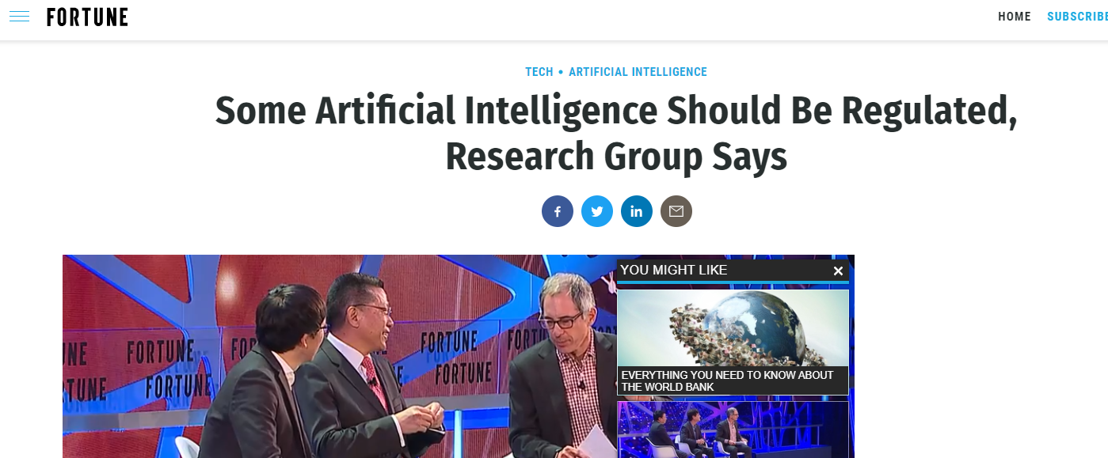
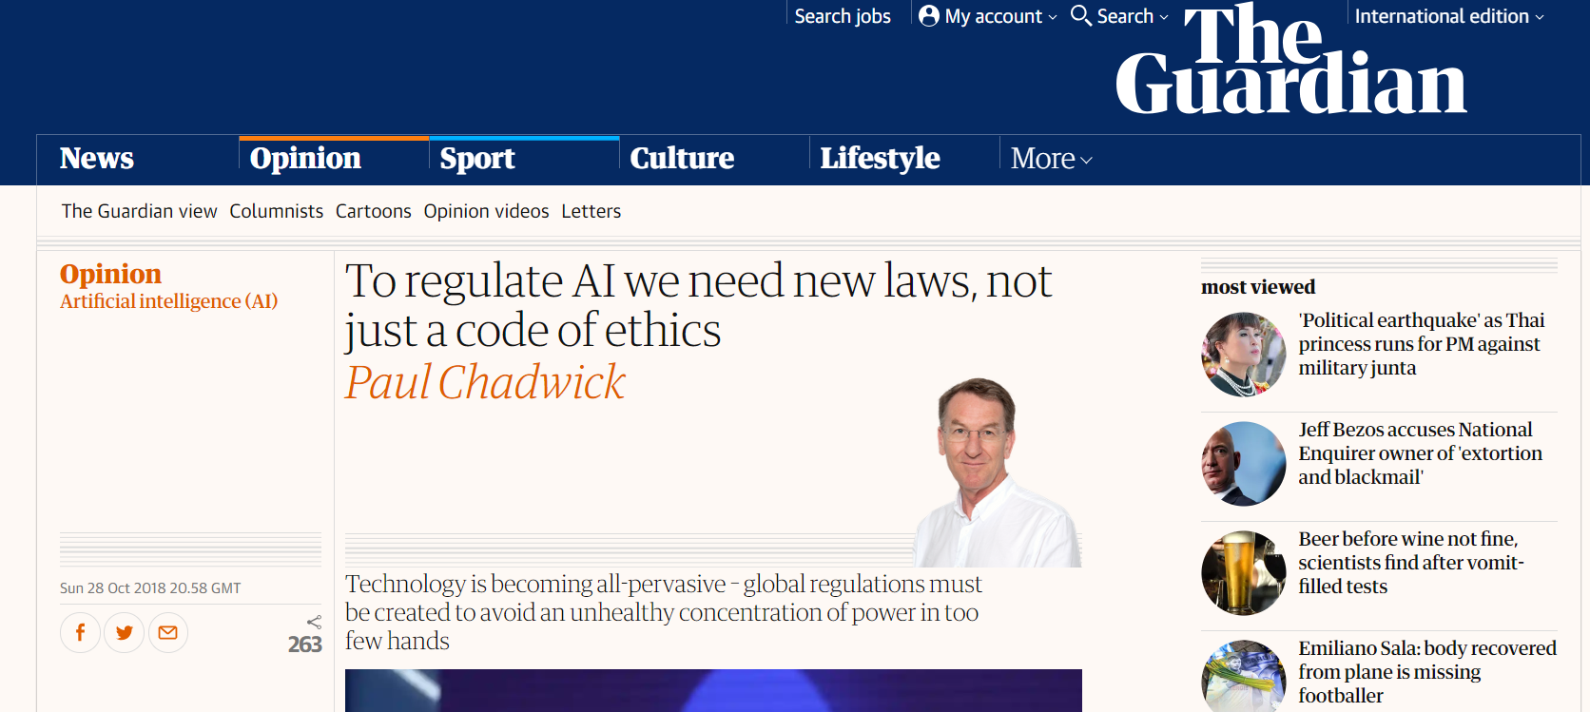
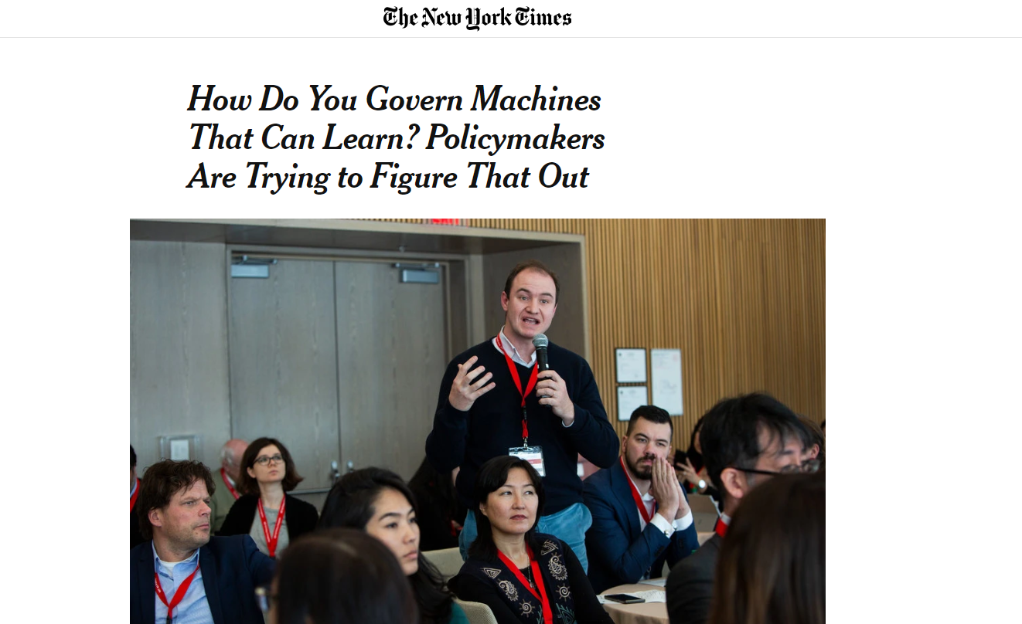
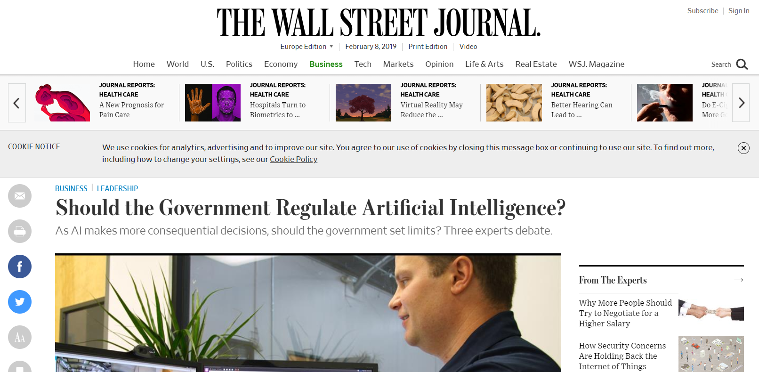
Some headlines

Slide 10
2
2
The rise of AI & Machine Learning

Slide 11
Table of contents
Introduction and Motivation
The rise of AI & Machine Learning
History
Vocabulary and Key concepts
Recent developments & challenges
Building an auditing an AI
Enablers for auditing
Responsible and ethical AI
Q & A

Slide 12
History

Slide 13
AI is Not New
The enablers of enterprise AI have finally arrived!
Explosive Growth
New Hopes
Inflated Hype
POPULARITY
Birth
AI Winter I
AI Winter II
TIME
1956
1974
1980
1987
1993
Confidential information for the sole benefit and use of PwC’s client.

Slide 14
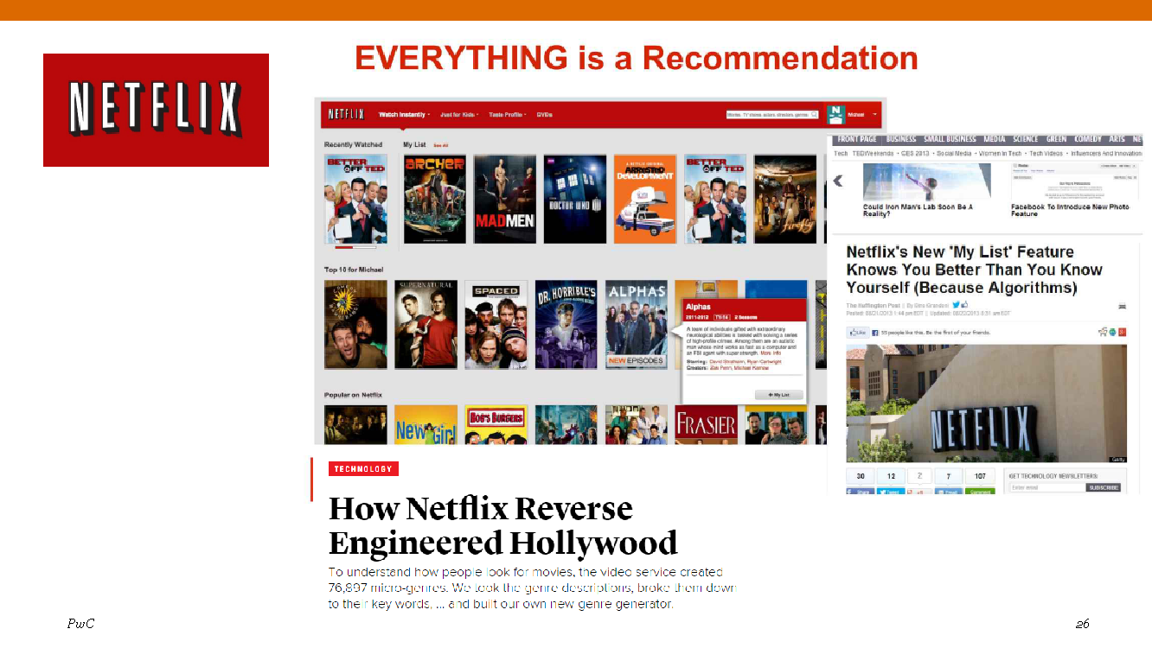











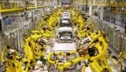
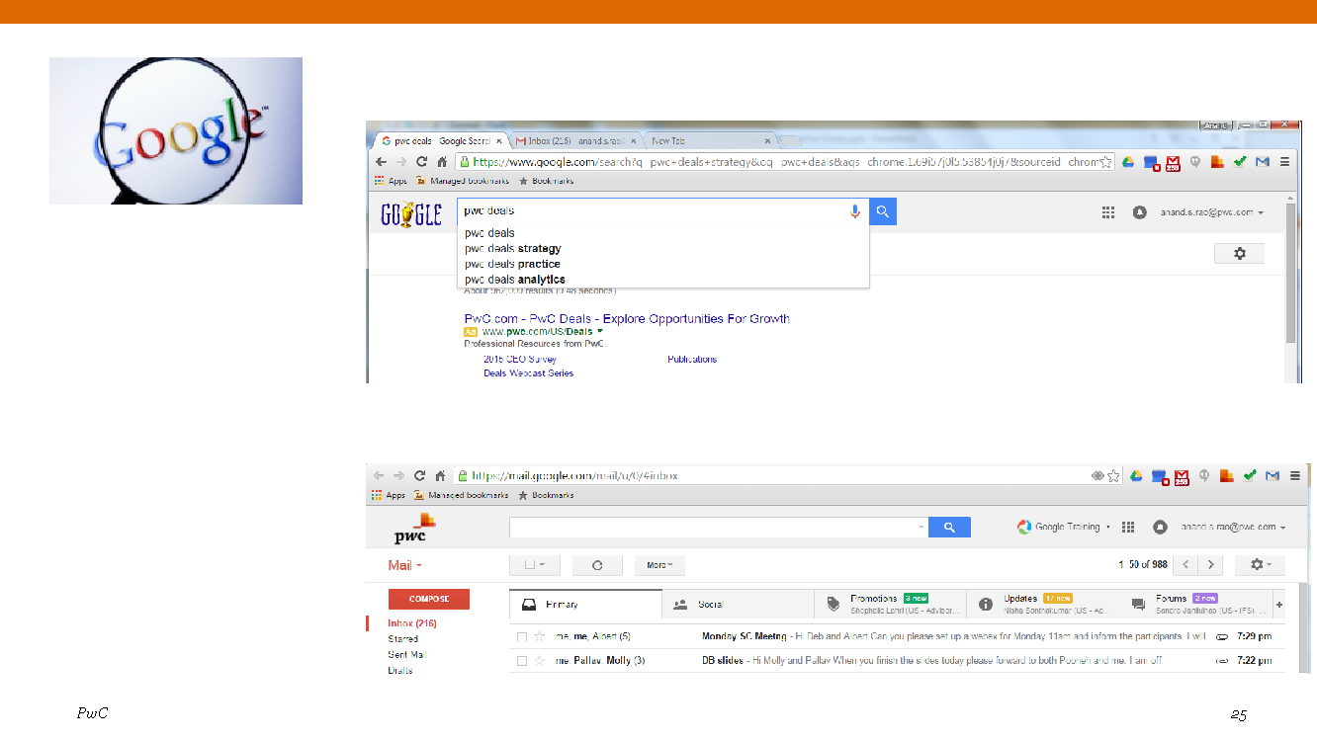
History
Narrow AI (Rule-based, Speech)
Narrow AI – with Big Data
(B-2-C, Search, Ecommerce)
Democratization & Embodied AI
Collaborative AI on new AI hardware
Artificial General Intelligence
Personalization: 76,897 micro-genres
Deep Learning – Image Processing
Home & Service Robots
Man-Machine Collaboration
Emotional Robots
Rule-based decisions
Handwriting & Voice Recognition
Self-driving vehicles
Neuromorphic Computing
Industrial Robots
NLP & Big Data
Past
90’s
00’s
Now
Next 5 Years
Next 20 Years
Future

Slide 15
Vocabulary and key concepts

Slide 16
Vocabulary and key concepts
Data
Information
Data is the fuel of Machine Learning. Data is any kind of digitised information, and Machine Learning can deal with any type of data: structured, semi-structured and unstructured. From a large amount of data, relevant features are extracted to train ML/AI models.
Bias
Systematic error
There are different concepts and sources for bias. Statistical bias is a systematic error that is made when computing predictions. But it is also possible that AI engineers introduce their own personal biases into the system. Responsible AI aims at eliminating personal bias, while statistics help reduce statistical bias.
Machine Learning
Applied statistics
Machine learning is a set of techniques and algorithms that allow computers to learn and perform a task.
AI system
Set of tools
Any tool that applies methods of ML/AI in a broader scope of algorithms to reach a specific goal.
Artificial Intelligence
Artificial Intelligence is a general term that groups computer systems able to perform tasks that ordinarily require human intelligence. Artificial Intelligence relies a lot on Machine Learning and Deep Learning, among other techniques, to perform tasks that were part of science-fiction several decades ago, such as self-driving cars.
(Un)Supervised Learning
Classification of AI
Supervised Learning algorithms require input data to be paired with an output, so that the AI can learn the patterns of input that form a certain output. In unsupervised learning, AIs are able to learn without being given an output beforehand.
Prediction
Result, output
AI & ML are all about providing predictions conditionally on an output. Techniques exist to understand why certain predictions were made, but also to make sure they are coherent.
Model
AI algorithm
Models are the result of a training process and analyze input data to generate predictions.

Slide 17
What is AI Capable Of?
Artificial Intelligence
system
Learns from
experience
Uses the learning
to reason
Recognises
images
Solves complex
problems
Understands language
and its nuances
Creates
perspectives
Confidential information for the sole benefit and use of PwC’s client.
Notes:
The future is not and extension of the present: businesses either transform or become irrelevant (based on a Gerd Leonhard’s statement)

Slide 18
Machine Learning positioning in the data spectrum
Pattern recognition
STATISTICS
DATA
MINING
MACHINE
LEARNING
ARTIFICIAL INTELLIGENCE
Knowledge Discovery
Databases

Slide 19
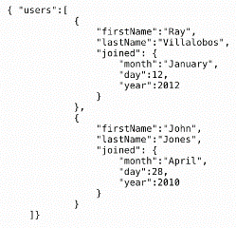
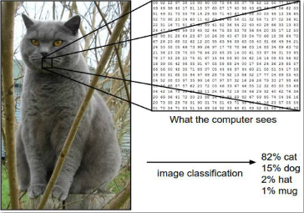
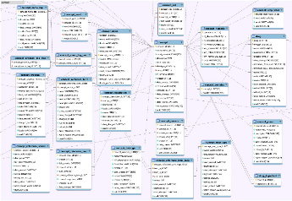
Types of data: structured, semi-structured & unstructured
Structured
Semi-Structured
Unstructured
Information with a fixed data model or schema, typically stored in tabular formant
Labeled or organized data with no guarantee of data model consistency
Information has no defined schema or structure
Examples:
Relational Database
CSV, Excel
Examples:
JSON/XML
Social Media
Examples:
Text
Images/Audio/Video
Sensor Data
Confidential information only for training purpose (refer to disclaimer)

Slide 20


Key concepts in practice
Once the Neural Network is trained, it constitutes a model;
A very large Neural Network would be considered as a Deep Learning algorithm.
Sharp ears
Mammals
Big blue eyes
Feline
Young
Brick wall
Kitten
Young kitten. Mouth open
???
Brick wall
Cute
Tongue
Brick wall
Data
Features
Neural Network, an example of a supervised learning algorithm
Prediction

Slide 21


Is there a dog in this picture? An example of Bias in the data
Confidential information for the sole benefit and use of PwC’s client.

Slide 22



Type of machine learning algorithms
Sorting Lego Blocks: Example of a child sorting Lego blocks illustrates the differences between the three machine learning styles
Supervised
Child has to sort the colored blocks by matching the colors of the block with the colors of the bag
Unsupervised
Child has to sort blocks by color, shape or both with no instructions
Reinforcement
Child get feedback from Mom when he does something right or wrong
Confidential information for the sole benefit and use of PwC’s client.

Slide 23
Recent developments and challenges

Slide 24
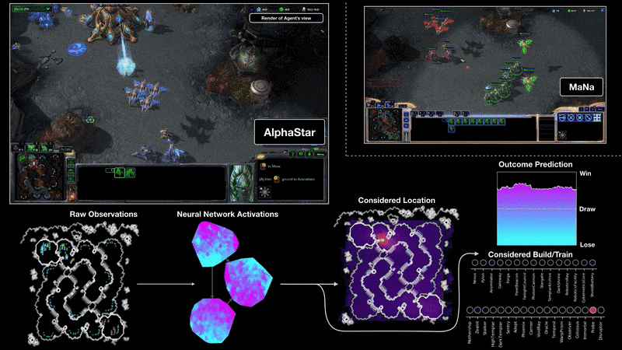
Recent developments and challenges
Artificial Intelligence systems capable of beating humans at more and more complex games
AlphaStar, an AI capable of winning StarCraft II against professional players;
StarCraft II is a Real Time Strategy game requiring Game Theory with imperfect information and long term planning;
The game is very fast-paced and complex, and yet AlphaStar was able to beat a professional player

Slide 25

Recent developments and challenges
Google Duplex: A.I. Assistant Calls Local Businesses To Make Appointments
https://www.youtube.com/watch?v=D5VN56jQMWM

Slide 26

Recent developments and challenges
“DeepFake” is the use of Deep Learning techniques to swap faces between an original video and a target scene.
This technology could be a threat to our communication ecosystem by spreading fake news.
Output
Input
Source: https://www.youtube.com/watch?v=ttGUiwfTYvg

Slide 27

3
3
Building and auditing an AI
Notes:
Proposed approach for the market study

Slide 28
Table of contents
Introduction and Motivation
The rise of AI & Machine Learning
Building an auditing an AI
Building an AI
Auditing an AI
Auditing Use-case
What are the regulators doing?
Enablers for auditing
Responsible and ethical AI
Q & A

Slide 29
Building an AI

Slide 30

Knowledge Discovery from Data (KDD)
Selection
Original Data
Preprocessing
Target Data
Transformation
Preprocessed Data
Data Mining
Transformed Data
Interpretation
Patterns
Knowledge
Confidential information for the sole benefit and use of PwC’s client.

Slide 31
How Machine Learning (ML) works
1
2
3
Select Data:
Split the data you have into three groups: training data, validation data, and test data.
Train model:
Use the training data to build the model using the relevant features.
Model Validation:
Assess the model with your validation data.
6
5
4
Tune model:
Improve performance of the algorithm with more data, different features, or adjusted parameters.
Use the model:
Deploy the fully trained model to make predictions on new data.
Test model:
Check performance of the validated model with your test data.
Confidential information for the sole benefit and use of PwC’s client.

Slide 32
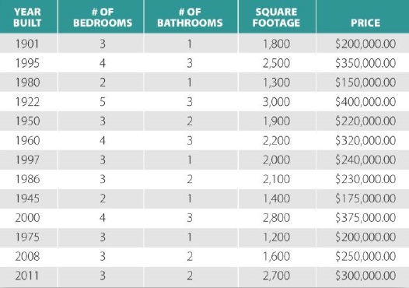
Supervised learning : basic terminology
1
2
3
6
5
4
Target
or Objective
Given a set of known attributes of a house, predict the price.
Given the pattern of features, predict target
Feature or Attribute or Predictor
Observation
or
Record
Confidential information for the sole benefit and use of PwC’s client.

Slide 33
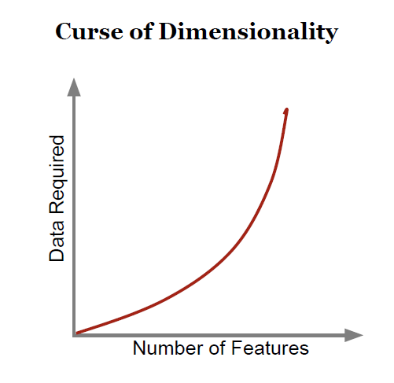
Feature engineering
1
2
3
6
5
4
Feature: some attribute of your data (e.g. square footage, occupation, height, favorite color)
Feature Engineering: the selection/ definition of which features to include in your model. This includes new feature generation.
Good Feature Engineering requires domain knowledge, an understanding of the data, and lots of experimentation.
With increased number of features, noise to information ratio may also increase.
The more features used to predict a target, the more data required
Confidential information for the sole benefit and use of PwC’s client.

Slide 34
Training, validation & test data
1
2
3
6
4
5
Training Data Set
(~60%)
Train different models on the training data
Validation Data Set
(~20%)
Fine tune hyper parameters and select best model
Test Data Set
(~20%)
Final test on unseen data
Note: a split 60%-20%-20% is common practice but depends on how much data is available.
Confidential information for the sole benefit and use of PwC’s client.

Slide 35































Training, validation & test data
1
2
3
6
5
4
But what if this image appears in the Test Data?
Training Data Set
(~60%)
Train different models on the training data
Validation Data Set
(~20%)
Fine tune hyperparameters and select best model
?
?
?
?
?
Test Data Set
(~20%)
Final test on unseen data
Confidential information for the sole benefit and use of PwC’s client.

Slide 36
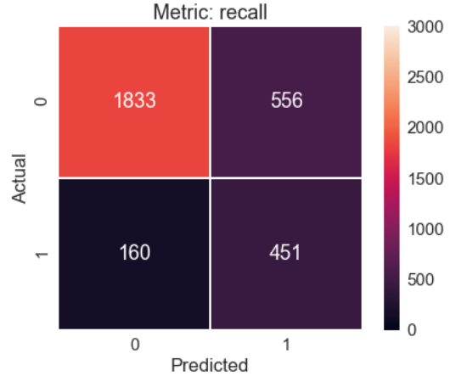
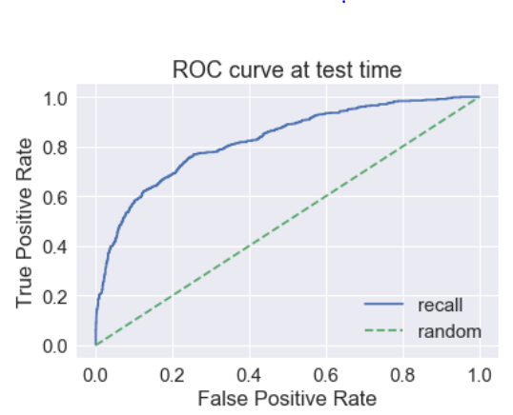
Confusion matrix and ROC curve: transaction prediction example
Some useful and common metrics:
Accuracy = (TP+TN) / (TP+FP+FN+TN)
Precision = TP / (TP+FP)
Recall = TP / (TP+FN)
F1 = 2*Precision*Recall / (Precision+Recall)
Positive Predicted Value (PPV) = TP / (TP+FP)
Negative Predicted Value (NPV) =TN / (TN+FN)

Slide 37
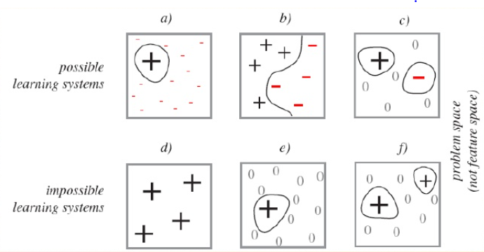
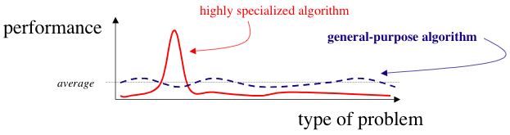
No universal learning machine
No Free Lunch Theorem
« No learning algorithm has an inherent superiority over other learning algorithms for all problems. »
(Wolpert, 1995)
« All optimisation methods are equally good, when averaged over uniform distribution of objective functions. »
(Wolpert & Macready, 1997)
Confidential information for the sole benefit and use of PwC’s client.
Notes:
Wolpert & Macready 1997
I Basic content: All optimisation methods are equally good,
when averaged over uniform distribution of objective
functions.
I Alternative view: Any nontrivial optimisation method must
be based on assumptions about the space of relevant
objective functions. [However this is very difficult to make
explicit and hardly any results in this direction exist.]
I Corollary: one cannot say, unqualified, that ACO methods
are “better” than GA’s, or that Simulated Annealing is
“better” than simple Iterated Local Search. [Moreover as of
now there are no results characterising some nontrivial
class of functions F on which some interesting method A
would have an advantage over, say, random sampling of
the search space.]

Slide 38
Auditing an AI

Slide 39
A simplified typical AI system
Data
Source of data
Training
Type of model
Deployment
Location
Results
Preparation and quality
Training & Testing
Online data sources
Predictions
Decisions
Available data is gathered and prepared for training a model
Appropriate model is chosen, tested and trained
Model is deployed for online usage
Outcome is predictions or decisions that are used in a business process
Notes:
Should get a good transition to next slide

Slide 40
A sensible AI system
Data
Source of data
Training
Type of model
Deployment
Location
Results
Preparation and quality
Training & Testing
Online data sources
Predictions
Decisions
Objective
Goal of AI
Process to be improved
The overall view is relevant
What problem are we trying to solve with the AI system?
Objective has to be taken into account

Slide 41
What parts of the system can be audited?
Data
Source of data
Training
Type of model
Deployment
Location
Results
Preparation and quality
Training & Testing
Online data sources
Predictions
Decisions
Objective
Goal of AI
Process to be improved
1 2 3 4 5 6
Several parts of the process in creating an AI system can be audited

Slide 42
1. Auditing AI system objective & management
The objective of an AI system should be clearly stated and targeted towards a specific problem - driving the other decisions of creating this system.
Questions to consider
Is there a legal basis for the considered use case?
What are the ethical or social impacts of the objective?
Are there processes in place to manage the deployment of new models? Are those following best practice?

Slide 43
2. Auditing data management
An AI system should consider only the strictly required amount of data and make sure that anything contributing to the creation of models is traceable
Questions to consider
Is there data management in place in the organization?
Is the data used for the AI training, testing and validation of high quality?
Are there data auditing tools in use that can manage this specific type of data?
Has the data been checked for potential bias?

Slide 44
3. Auditing AI security
The AI system shall handle all communication of data securely, making sure that there is no way to alter information in the process that may effect the outcome
Questions to consider
Are the systems communicating over encrypted channels?
Is there a security management in place?
What actions are taken when there are security challenges?

Slide 45
4. Auditing model training
The model chosen should fit to the specific objective, to prevent undesired outcomes and make the overall system more stable
Questions to consider
Have best practices been followed in model selection?
Are processes in place to prevent overfitting of data?
Are deterministic or predictive models needed?
Are several models being tested and their performance validated?
What are the parameters chosen to evaluate system performance?
Is the model suitable for the deployment requirements (e.g. processing time)?

Slide 46
5. Auditing model deployment
A deployed AI system should be stable and robust towards unfavourable input data. It should be validated in realistic operation scenarios and perform according to the specified requirements.
Questions to consider
Has the model been validated with a significant amount of data?
What is the performance of the model during live operation?
If the model is supporting relearning - are there set boundaries? How do the retrained models behave?
What kinds of stress tests have been performed on the system?
Has the system been tested against typical attacks on AI?

Slide 47
6. Auditing AI results
The results of an AI system should be of high performance, according to the specific requirements. Probabilistic models should perform with a high statistical significance.
Questions to consider
Are the results of the system as expected?
Is there monitoring of the results in place? Does it look for outliers or unexpected results?
Is there ongoing validation of the results against the expected baseline?

Slide 48
Auditing Use Case

Slide 49
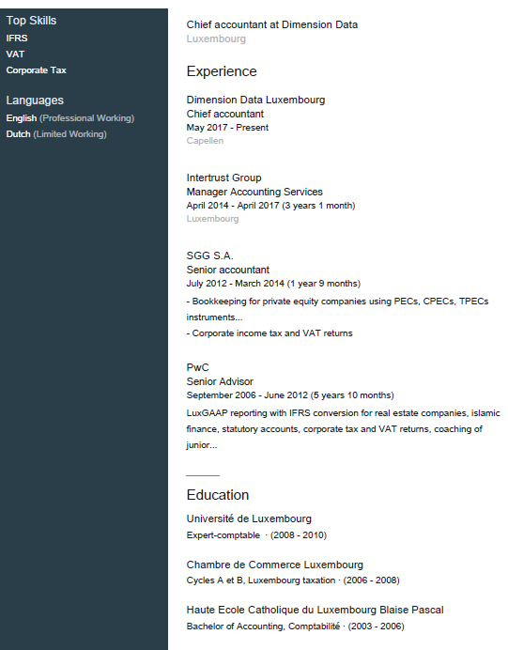
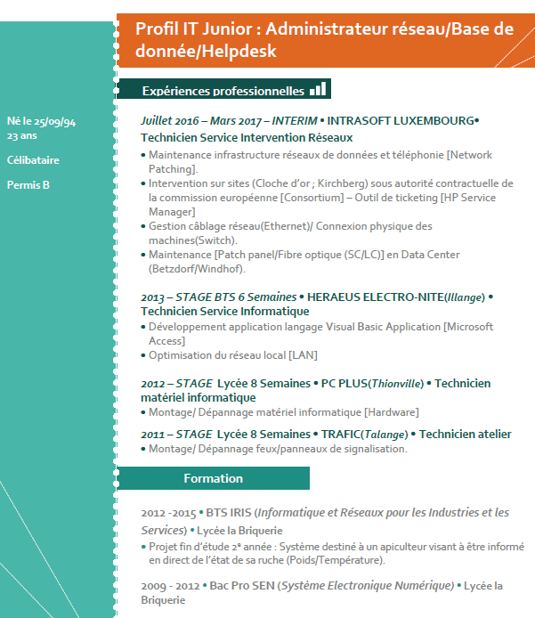

Auditing Use Case: an AI powered job suggestion tool assessment
Generate a set of test cases covering the wider range of input possibilities:
A set of CV is generated to cover a representative range of different jobs. case
Financial services: Profile 1 - Accountant
Make variations of the initial test cases:
We create several sub-cases by changing one variable at a time in the CV generated.
Information Technology: Profile 2 – IT specialist
Blue collar: Profile 3 - Cook
Profile 1
Profile 1.1
…
Profile 1.2
Change in seniority
Profile 1.3
Change in education level
Presentation Title
Date

Slide 50
Auditing Use Case: an AI powered job suggestion tool assessment
We compare the outputs obtained between slightly different inputs
Compare the results obtained for two test cases allows to measure the effect of one variable change in the inputs.
The behaviour of the model must be assessed to ensure reactivity to the proper variables. In particular, we must check the absence ethical bias and ensure a Responsible AI.
Comparison between cases differing from a relevant variable: the solution should change
For instance, two CV having a change in seniority, all other things equal, should propose different jobs.
Comparison between cases differing from an out of the scope variable: the solution should change
Two CVs having a changed gender, ethnical origins, age should not be proposed different jobs

Slide 51
Use Case: an AI powered job suggestion tool assessment
We communicate the result to the tool provider
The test is performed in several phases. At the start of each phase, the process restart at step 1 with the generation of test cases. At the end of a phase, the observations on the model are communicated to the provider. The solution is accepted only once the acceptance criteria met.
It allows the provider to improve its solution and to the client to ensure the proper behaviour of its model.
Step 1
Test case generation
Step 2
Small variations of cases
Step 3
Assessment
Step 4
Communication of the results
Presentation Title
51

Slide 52
What are the regulators doing?

Slide 53

“ […] We may need, as a regulator, to look under the hood or behind the curtain to see what data were used, what training data were used, what factors were programmed into the system and what question the AI system was trained to answer.”
Elizabeth Denham, UK Information Commissioner, oral evidence to the House of Commons Science and Technology Committee, January 2018
Confidential information only for training purpose (refer to disclaimer)

Slide 54
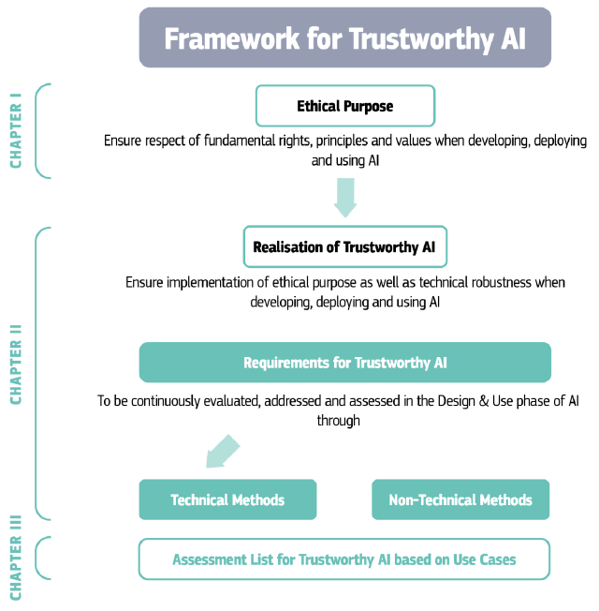
Trustworthy AI is on the agenda of the EU
Final version of the document is due in March 2019
Source: Ethics Guidelines for Trustworthy AI
https://ec.europa.eu/newsroom/dae/document.cfm?doc_id=57112

Slide 55






AI standardization in Europe/worldwide
61 national standards
60,201 European standards from CEN CENELEC and ETSI
60,729 international standards from ISO and IEC
Other open technical standards

Slide 56

Standardization of AI worldwide: ISO/IEC JTC1/SC 42
Participating countries: 22
Portugal
Netherlands
Russia
Sweden
Spain
Switzerland
United Kingdom
United States
Australia
Austria
Canada
China
Denmark
Finland
France
Germany
India
Ireland
Israel
Italy
Japan
Korea
Luxembourg
PwC’s Digital Services

Slide 57

The further development and promotion of such safety standards and support in EU and International standardization organizations will help enable European businesses to benefit from a competitive advantage and increase consumer trust.
-EC COM(2018) 237 ‘Artificial Intelligence for Europe’
Confidential information only for training purpose (refer to disclaimer)

Slide 58

IEEE ethics for Autonomous and Intelligent Systems (AIS) Tehnical standards and regulation for AI
Independent working groups
Model Process for Addressing Ethical Concerns During System Design
Standard for machine readable human privacy terms
Wellbeing Metrics Standard for Ethical Artificial Intelligence and Autonomous Systems
Transparency of Autonomous Systems
Establish broad consensus
IEEE P7000™
Fail-Safe Design of Autonomous and SemiAutonomous Systems
Data Privacy Process
Pressing ethical/social AI issues
: Algorithmic Bias Considerations
Standard for Ethically Driven Nudging for AI
Standard on Employer Data Governance
Ontological Standard for Ethically Driven Robotics and Automation Systems
Standard on Personal Data AI Agent Working Group
Ref: https://www.businesswire.com/news/home/20161213005259/en/IEEE-Ethically-Aligned-Design-Document-Elevates-Importance

Slide 59



Use of Artificial Intelligence by Regulatory Authorities around the World
Japan
Enhancing the customer-orientated services offered by the banks, especially the selling of financial products like investment trusts
Analyzing the contents of interview transcripts to provide information on parameters like productivity, workload, accuracy, etc.
Comparing the results of the work of the AI engine and the human staff
Turkey
Estimating Deposit Banks Profitability with Artificial Neural Networks
Easiness on estimating bank profitability, since giving such successful estimations and not being affected by user differences
Generalization capability is an important advantage of ANN. Thanks to these capabilities, they start to estimate new patterns with high accuracy
USA
Identifying potential instances of cross-asset manipulation that uses options and equities
Using Machine Learning to detect cases beyond 270 predefined patterns it currently looks for
Notes:
FSA
Productivity and Efficiency of Customer-Orientated Operations – Banks provided them with the records (including telephone records) of the conversations between their customer support representatives and customers.
They used FRONTEO’s KIBIT engine to analyze data
https://bit.ly/2LcDuRN
BDDK
Estimating Deposit Banks Profitability with Artificial Neural Networks – most important step is the deciding parameters like which dependent and independent variables should use which intrinsic (CEO’s decisions) and extrinsic(macro-economy ) variable should use for enrichment etc.
https://bit.ly/2GeJlHn
FINRA
Artificial Intelligence Could Catch Stock Market Cheaters --FINRA monitors roughly 50 billion market “events” a day, including stock orders, modifications, cancellations, and trades. It looks for around 270 patterns to uncover potential rule violations. It would not say how many events are flagged. In some case they could miss manipulations and their big concerned was , there would some manipulative scheme that they were not even aware of it.
https://bit.ly/2erezht
https://bit.ly/2scb58H

Slide 60



Use of Artificial Intelligence by Regulatory Authorities around the World
Australia
Automated data review of a larger number of files to identify files for further investigation using NLP technology
Partnership with a “regtech” firm to leverage cognitive learning tools on webpages of accountants
Unearthing potential misleading or unlicensed conduct in self-managed superannuation fund (SMSF) activities
Reviewing of the advertising and promotion of financial products
Australia
Working with researchers at RMIT University in Melbourne
Detecting and deterring suspicious activity
Detecting unknown money laundering networks more speedily and accurately than ever before
Flagging transactions that needs to be further investigated
UK
Anomaly detection in anonymized credit union datasets included historical data
Drawing out sentiment and qualitative insights from publicly available information
Automatically flag new information of regulatory interest for review in large amount of weakly-structured textual information
Cloud-based analysis of limit order book data from a number of trading exchanges using new generation of Big Data tools
Notes:
ASIC
ASIC eyes AI to crack down on dodgy financial practices – They focus on the NLP technologies. The job of reviewing advertising from radio, TV, print, billboards and online is currently undertaken manually. When ASIC reviewers find an issue of concern, their first step is to draft an initial letter to the financial entity setting these out. Their aim is : 1.monitor advertising across all media, including social media 2.automate the drafting of initial correspondence.
https://bit.ly/2LcXSlK
https://bit.ly/2UG3BoD
Prudential Big Data Anomaly Detection Tool & Big Data Text Analytics -- The Bank of England has established a FinTech Accelerator to work with innovative firms (startups)and new technologies. In this purpose they start to use Big Data Technologies especially cloud solutions architect
https://bit.ly/2rxxjib
https://bit.ly/2SFAQXh
AUSTRAC
Detect Unknown Money Laundering
https://bit.ly/2M0HzHE

Slide 61
4
4
Enablers for auditing an AI
Notes:
Proposed approach for the market study

Slide 62
Table of contents
Introduction and Motivation
The rise of AI & Machine Learning
Building an auditing an AI
Enablers for auditing
Human Resources
Technical Resources
An Ocean of technologies to support AI
Responsible and ethical AI
Q & A

Slide 63
Human Resources

Slide 64
What it means to look inside AI’s black box

Slide 65
Specialized profiles are required to look inside the blackbox
Scripting languages
Predictive analytics
Computer
Science
Maths &
statistics
Data preparation
Machine
Learning
Data governance
Model fitting
SQL
Data
Science
Data
Engineering
Data
Analysis
Experimental design
Advanced math
Get the right Data
Business expertise
Constraints (Privacy, legal)
Statistical packages
Translate for nontechnical audience
Understand customers
Define metrics that matter
Confidential information for the sole benefit and use of PwC’s client.

Slide 66
Technical Resources

Slide 67
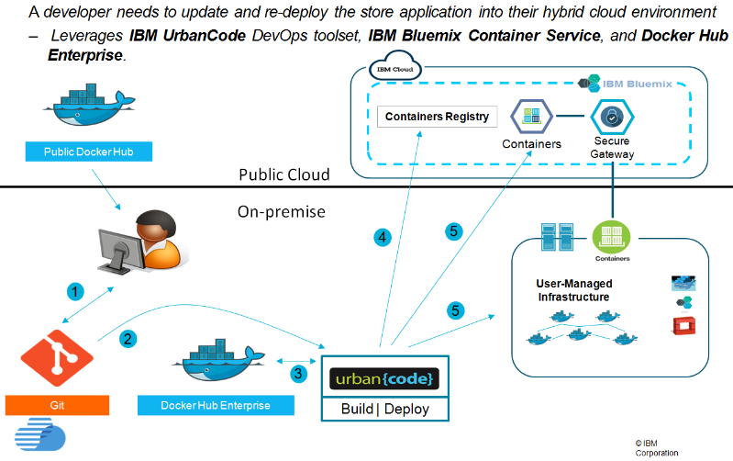

Enablers for AI auditing – Automatic deployment
Tooling for building and
packaging
software using
containers:
Docker, Kubernetes
Makes it possible to standardize tools used to program AIs.

Slide 68
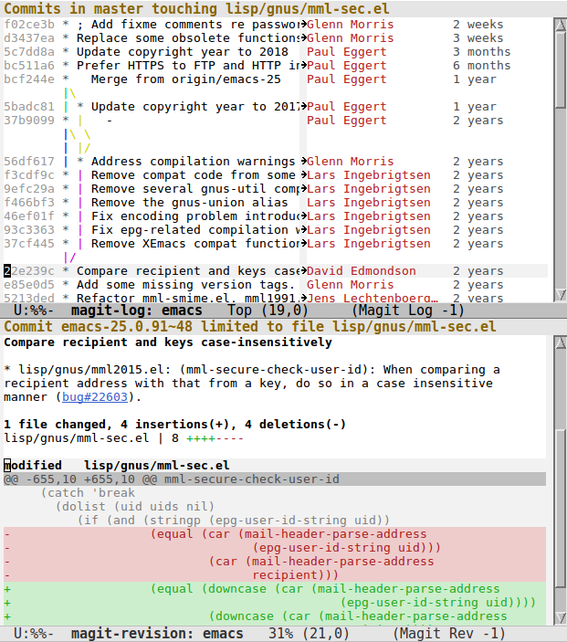
Enablers for AI auditing – Versioning systems
Versioning systems like Git provide the full audit trail of editing.
Makes it possible to know who changed what and when. It can be used to know:
What manipulations have been applied to data
How the models have been programmed

Slide 69
Enablers for AI auditing - Data quality management tools
Data quality review toolkits like: WHO-DQR/DQRA,REQA
They consider key dimensions such as
Accuracy
Integrity
Consistency
Completeness
Validity
…
These tools are to be considered in an organization’s data management strategy.

Slide 70
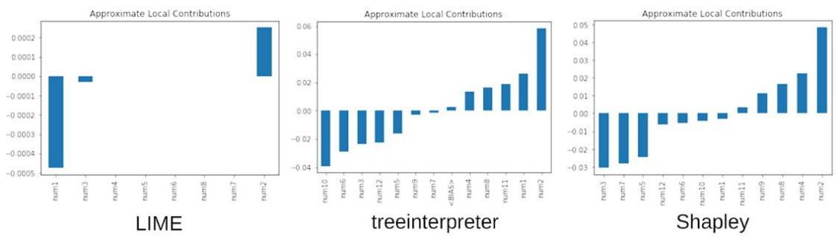
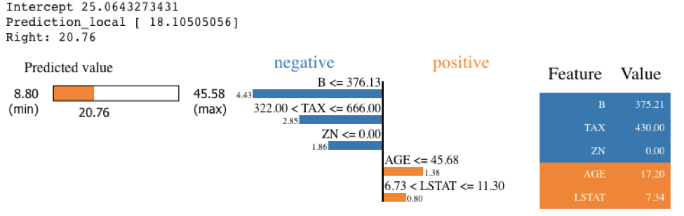
Enablers for AI auditing - Elucidate AI model interpretability
Human confirmation is probably the highest bar for machine learning interpretability
Other concerns regarding pre-existing expectations, preferences toward simplicity, and other bias problems could also be automatically tested using tools like SHAP/ LIME
Notes:
Figure 4. Local variable importance for an XGBoost model trained on random data. Figure courtesy of H2O.ai.

Slide 71
An Ocean of technologies to support AI

Slide 72
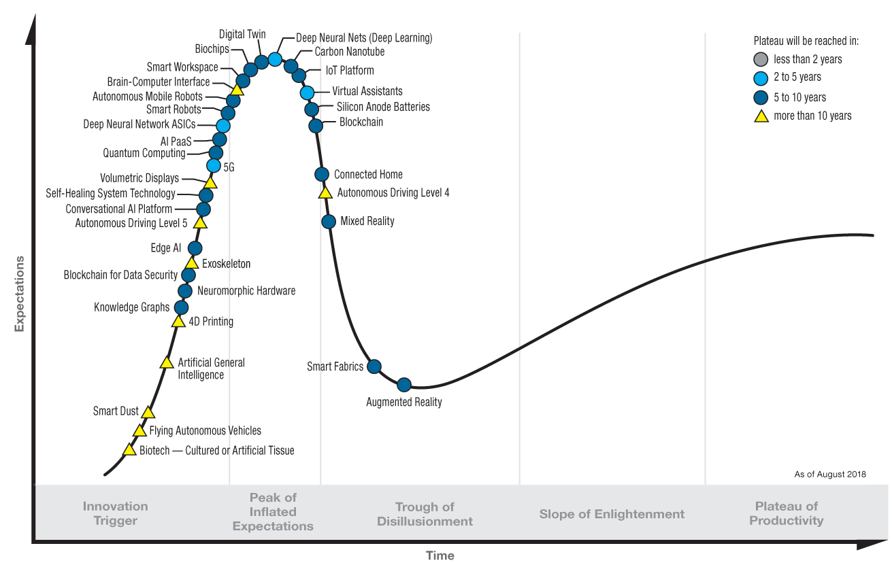
Gartner Hype Cycle for Emerging Tecnlogoies, 2018
gartner.com/SmarterWithGartner

Slide 73
Despite a number of AI-related use cases, the banking sub-sector within FS has been slower to adopt AI compared to insurance and asset management
AI Adoption within three sub-sectors of Financial Services
 | Banking | Asset Management | Insurance
Main use Cases | Make customized portfolio recommendations (e.g. robo-advisors) Automate Back-Office functions Monitor and reduce payments fraud Improve customer experience in online and mobile channels Social CRM systems using Sentimental analysis Bank agent meeting preparations | Automate tasks and processes in the value chain such as reporting, compliance monitoring, trade reconciliation Monitor and reduce Fraud Automate trading (e.g. algorithmic trading and high-frequency trading) | Process claims Enhance customer experience and customer targeting Automate customer service Manage distribution Analyze behavior of policyholders Mitigate risk Automate underwriting
AI Adoption Level | Banking participants have been slower to adopt AI solutions since many banking use cases rely on the use of customer data which several banks are obligated to protect for privacy reasons. | High frequency trading has been largely infused and Automation is picking up. | The utility of AI within Insurance has largely been driven by high deployment of Internet of Things (IoT) and sensor-related Technologies.
Increasing level of Adoption

Slide 74
AI has drawn significant attention from investors over the last five years, with machine learning solution providers raising the highest funding

Slide 75
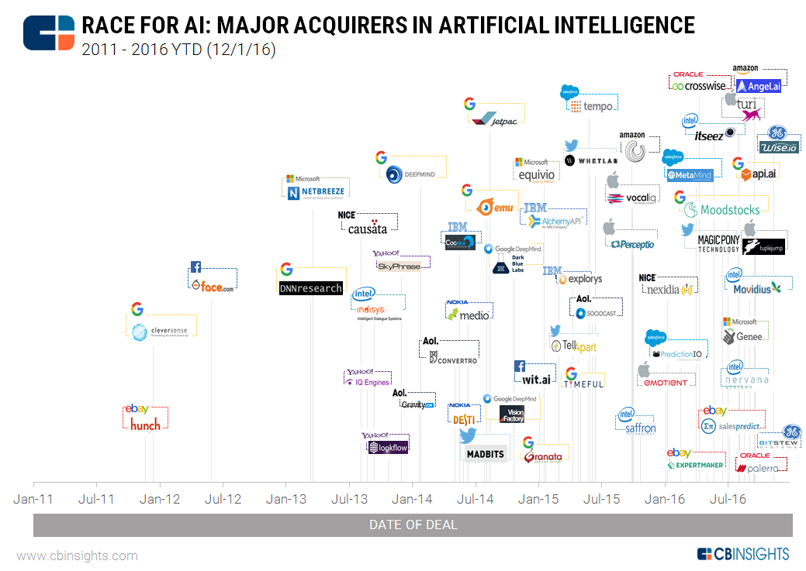
Tech Giants are accelerating Acquisitions

Slide 76
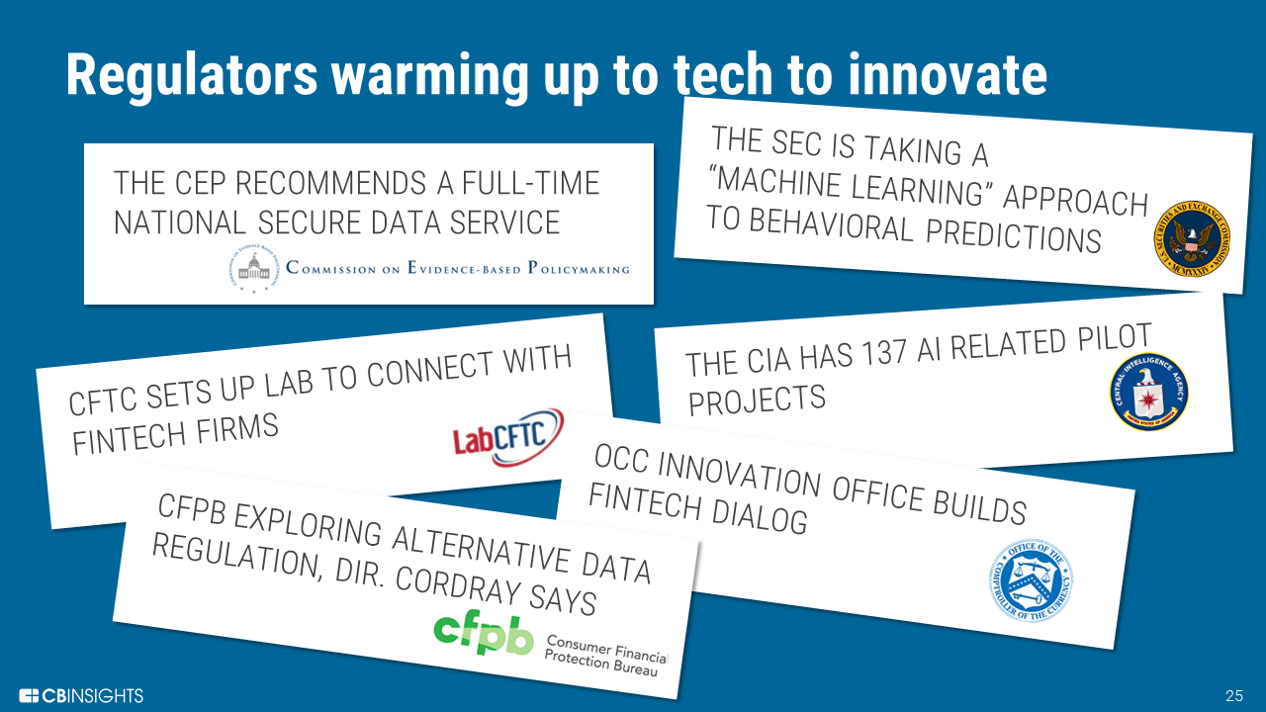
AI, a challenge and an ally for regulators
Notes:
XML
In computing, Extensible Markup Language (XML) is a markup language that defines a set of rules for encoding documents in a format that is both human-readable and machine-readable.
Metnion NLP, that can handle unstructured data.

Slide 77
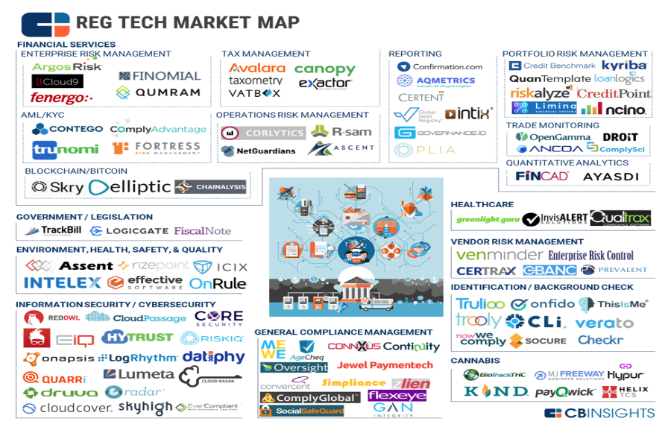
AI, a challenge and an ally for regulators
Notes:
XML
In computing, Extensible Markup Language (XML) is a markup language that defines a set of rules for encoding documents in a format that is both human-readable and machine-readable.
Metnion NLP, that can handle unstructured data.

Slide 78
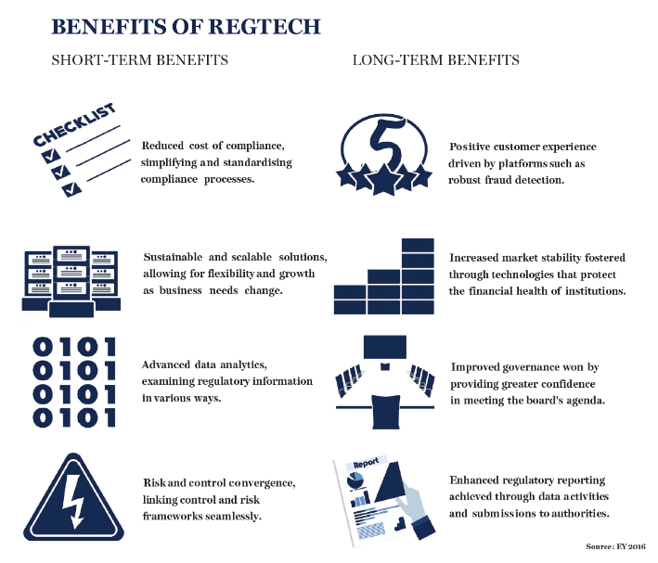
Benefit of AI usage in Regtech
Notes:
XML
In computing, Extensible Markup Language (XML) is a markup language that defines a set of rules for encoding documents in a format that is both human-readable and machine-readable.
Metnion NLP, that can handle unstructured data.

Slide 79
5
5
Responsible and Ethical AI
Notes:
Proposed approach for the market study

Slide 80
Table of contents
Introduction and Motivation
The rise of AI & Machine Learning
Building an auditing an AI
Enablers for auditing
Responsible and ethical AI
Responsible, robust and beneficial AI
Analytics operating models
Q & A

Slide 81
Responsible, robust and beneficial AI

Slide 82
Responsible AI
Robust Artificial
Intelligence
Beneficial Artificial Intelligence
Concerned with the verification, validation, security and control of AI systems
Concerned with maximizing the social benefit of AI
Reduce or eliminate software risks
Reduce or eliminate security risks
Reduce or eliminate control risks
Reduce or eliminate societal risks
Reduce or eliminate ethical risks

Slide 83
We define
Responsible Artificial Intelligence
as the combination of building robust AI systems that will engender ‘trust’ in today’s AI system as well as work towards the development of AI that will be beneficial to society today and in the future.
Confidential information only for training purpose (refer to disclaimer)

Slide 84

Robust AI
Performance
Security
Control
Risk of Errors
Risk of Bias
Risk of Opaqueness
Risk of stability of performance
Cyber intrusion risks
Privacy risks
Open source software risks
Digital, Physical, Political
Risk of Autonomous Weapons proliferation
Risk of ‘intelligence divide’
“A Treaty can be effective in this regard by stopping an [autonomous weapons] arms race and preventing large-scale manufacturing of such weapons”. Why we should really ban Autonomous Weapons, Stuart Russell, Max Tegmark, and Toby Walsh.
COMPAS, a system used by US Judges to forecast which criminals are likely to reoffend was biased. It concluded that almost “blacks are almost twice as likely as whites to be labeled a higher risk but not actually re-offend.”
Charlie Miller and Chris Valasek were able to hack into a Jeep Cherokee through a vulnerability in Uconnect, the car’s internet-connected entertainment system. They were able to blast the air conditioner, increase the radio volume, and turn on and off the windshield wipers

Slide 85
Robust AI in banking
A user can trick machine learning models into missclassifying inputs to bypass a system or to intentionally influence a system outputs.
Intrusion Detection
Malware classification
Spam Detection
A malicious user can use these attacks to determine how to behave on a computer network to avoid detection.
A malicious PE’s byte-string code can be manipulated to such that a malware detection model misclassifies it as a normal PE.
Text in Spam emails can be manipulated to be misclassified as an acceptable email while still maintaining human readability.

Slide 86
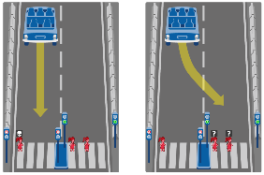
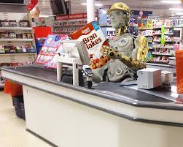
Beneficial AI
Ethical
Economical
Societal
‘LACK OF VALUES’ RISK
VALUE ALIGNMENT RISK
GOAL ALIGNMENT RISK
JOB DISPLACEMENT RISKS
‘WINNER-TAKES-ALL’ CONCENTRATION OF POWER RISK
LIABILITY RISK
SOCIETAL DISREGARD
MIT’s Moral Machine allows users to select scenarios to understand human ethics to determine what the ‘machine ethics’ should be.
A number of studies are predicting job losses, up to 50% or more, from automation in different sectors in different geographies.
Companies will deploy AI in any way to improve profits, regardless of the impact to workers and society.

Slide 87
As AI usage expands, it is important for organizations to understand their role in ensuring trust, transparency and reliability in AI powered decisions
1
2
3
Algorithmic Bias
Unintentional or intentional bias in machine-­learning systems can give rise to patterns of algorithmic discrimination with causes that may be difficult to identify.
Studies have found evidence of bias in online advertising, recruiting, and pricing strategies driven by presumably neutral algorithms.
Model Explainability
Machine Learning has advanced to the point where judgements cannot be easily explained, leaving organizations vulnerable to ethical and regulatory breaches (e.g., deep learning).
Managing the tradeoffs between the performance of a model and its interpretability is becoming more important than ever (e.g., ensemble models).
Decision Reliability
AI supported decision-making needs to be scalable and reliable, to allow all employees to consistently make the same quality of decisions, irrespective of individual ability and experience.
This level of consistency will have significant benefits for companies and individuals in terms of accountability and liability.
Confidential information only for training purpose (refer to disclaimer)
Notes:
https://sqrrl.com/explainability-machine-learning/#sthash.ZPjmiUJA.dpuf
https://www.technologyreview.com/s/601775/why-we-should-expect-algorithms-to-be-biased/
https://www.technologyreview.com/s/600996/artificial-intolerance/?set=600969
http://www.huffingtonpost.co.uk/ben-taylor1/aipowered-decisionmaking-_b_12879730.html
https://phys.org/news/2016-10-reliability-artificial-intelligence.html
https://hbr.org/2016/11/what-it-will-take-for-us-to-trust-ai

Slide 88
Analytics operating models

Slide 89
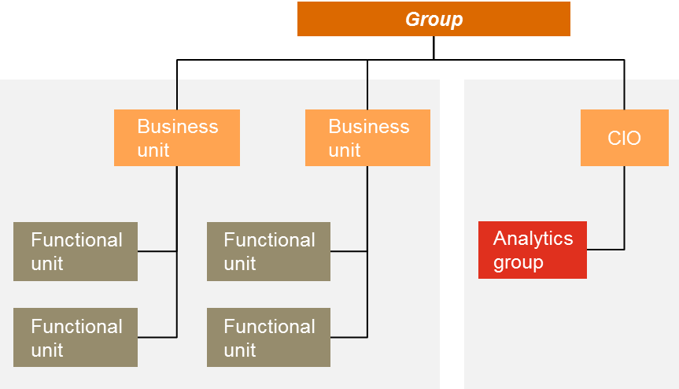
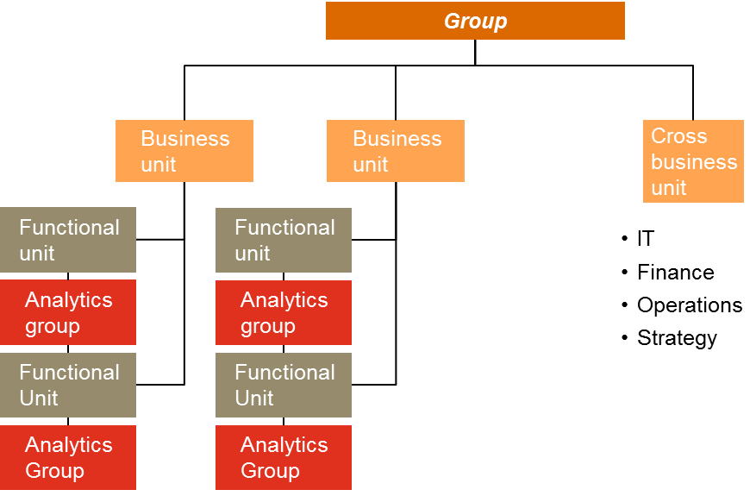
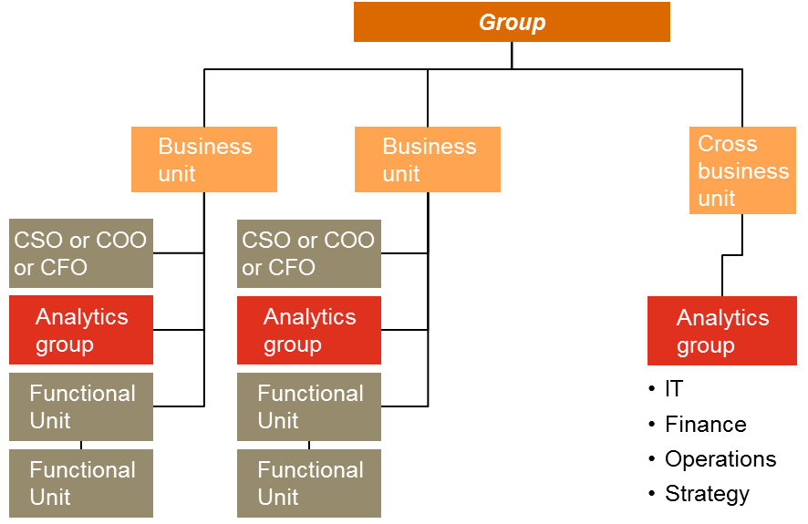
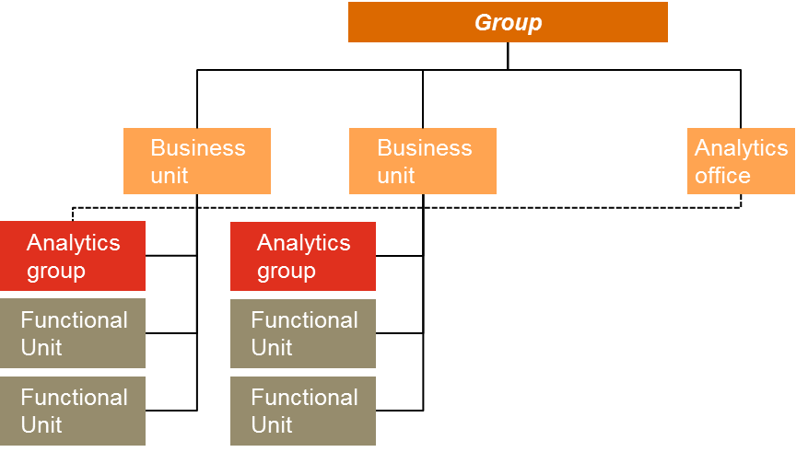
Designing the Analytics Operating Model based on value expectations is critical to inform the accountability, incentives, metrics, skills, data architecture, etc.
Information Enabler Model
Function Engine Model
Performance Optimizer Model
New Value Creator Model

Slide 90
1. Information Enabler Model
Focused on data delivery, data management, reporting and business intelligence functions
Analytics group reports to the CIO at the Group Level or to the CIO at the Business Unit level in a large global organization
Business analytics takes place at the business unit or function level
Success based on service delivery efficiencies and cost management
Skills focused on data tech.– data storage, data management, data security etc.

Slide 91
2. Functional Engine Model
Focused on data delivery, data management, reporting and business intelligence functions
Multiple analytics groups at the function level within some or all business units reporting to the functional head
Business analytics focused at improving and enhancing functional decision making
Success based on function metrics (e.g., marketing – conversion ratio)
Skills focused on combination of functional and analytics expertise

Slide 92
3. Performance Optimizer Model
Focused on improving x-function business unit decision making
Cross-functional analytics group reporting to a cross-functional executive – CSO, COO, CFO in one or more business units
Success based on improving business unit metrics (e.g., demand forecasts, B.U profitability)
Skills focused on combination of business knowledge and advanced analytics – including forecasting and scenario analysis

Slide 93
4. New Value Creator Model
Focused at improving and enhancing business unit decision making as well as innovative applications
Analytics group reports directly to the Business Unit head and optionally to a Chief Analytics or Data Science officer
Success based on improving business unit metrics, products/service sales and causing/responding to disruptions
Skills focused on combination of business knowledge, advanced analytics and innovation

Slide 94
The fundamental aspects that make AI “responsible”
Performance
Operations
Society
Bias
Testing for bias in the data, model, and human use of AI algorithms to improve fairness of treatment across groups
Interpretability
Adding transparency, explainability and provability to the modelling process to improve human understanding of the model outputs
Robustness & Security
Improving security and robustness of AI through rigorous validation, continuous monitoring and maintenance, verification and adversarial modelling
Governance
Designing effective AI operating models and processes to improve accountability and quality
System Ethics, Morality & Legal
Helping clients understand the systemic and moral implications of their use of AI
If an HR machine learning algorithm is trained on current recruiting decision data, it may inherit the same subconscious biases as human recruiters (racism, sexism, ageism)
Tay, a Microsoft chatbot, released to interact with the public began tweeting racist and inflammatory remarks in under 24 hours, without explanation
As with other technologies, cyber-attacks can penetrate, slow, and fool AI. As AI technology develops, attackers will surely find new means of attack.
AI is currently developed and maintained in silos, creating confusion and uncertainty. Just as businesses audit financial and operating practices, they must also be able to audit their AI systems.
Many advancements in AI increase automation, often resulting in job loss and replacement
Confidential information only for training purpose (refer to disclaimer)

Slide 95

Thank You !
Confidential to the usage of personnel participating to the training delivered by PwC
This publication has been prepared for general guidance on matters of interest only, and does not constitute professional advice. You should not act upon the information contained in this publication without obtaining specific professional advice. No representation or warranty (express or implied) is given as to the accuracy or completeness of the information contained in this publication, and, to the extent permitted by law, PricewaterhouseCoopers, Société coopérative, its members, employees and agents do not accept or assume any liability, responsibility or duty of care for any consequences of you or anyone else acting, or refraining to act, in reliance on the information contained in this publication or for any decision based on it.
© 2019 PricewaterhouseCoopers, Société coopérative. All rights reserved. In this document, “PwC” refers to PricewaterhouseCoopers, Société coopérative, which is a member firm of PricewaterhouseCoopers International Limited, each member firm of which is a separate legal entity.

Slide 96
Appendix

Slide 97
What other regulators have said

Slide 98

UK’s FCA / PSR stresses governance and ethics
Governance
System Ethics, Morality & Legal
Charles Randell, Chair of Financial Conduct Authority (FCA) and Payment Systems Regulator (PSR):
“I want to set out some of the questions we need to debate and resolve if we are going to make sure that technological innovation remains a force for good in financial services and that it protects and enhances our freedom to make good decisions as people, not just numbers… If we can combine these skills with fair standards and with public trust, we can maximise the opportunities for the UK finance industry to succeed in the global market.”
“I would like the UK regulatory community to add another asset – the leadership in regulation that it has already shown through programmes like the FCA’s Project Innovate and the Sandbox, while safeguarding high standards of consumer protection. ... We need to contribute to new standards for data ethics too. The FCA and the PSR are fully supportive of the government’s proposals to establish a Centre for Data Ethics and Innovation to ensure that the UK sets the highest standards for ethical conduct in harnessing the power of Big Data.”
Emphasis on ethical innovation for the good of people/consumers, and the need for regulation in order to ensure this.

Slide 99

Bermuda Monetary Authority’s statement underscores the need for robustness and governance
Governance
Robustness & Security
Jeremy Cox, CEO of Bermuda Monetary Authority (BMA):
“We are already hearing about technologies that could drive truly massive economic transformations and disruptions in the coming years. We’ve seen our own government committing to digitise its property deed system and transfer it to blockchain. At the BMA, we have moved to electronic filing for some of our companies and we are considering the use of artificial intelligence. But we need to be aware of the risk factors. A recent study by Lloyd’s of London found that businesses in the US could lose $15 billion if a leading cloud service provider were to experience downtime of three days”
Speaks to the risks and dependencies of new technologies and the potential business losses which could result if not properly managed and maintained

Slide 100
Bermuda is still testing AI and working with tech firms
Robustness & Security
Craig Swan, Managing Director, Supervision, Bermuda Monetary Authority (BMA):
“We are also introducing exciting approaches with respect to supervisory technology (SupTech), working with respected technology firms, such as CipherTrace, to implement blockchain analysis (i.e., tracking transactions across the blockchain), and separately testing the implementation of artificial intelligence and machine learning across our financial sectors to enhance our AML/ATF and prudential analytics.”
“Operationally, the foundation will be laid for the eventual adoption of technology in supervision (suptech) through the utilisation of artificial intelligence and machine learning, such as natural language processing, to create supervisory capacity and enhance risk-based supervision. In 2018 this will involve further streamlining data science processes and enhancing capabilities within the Development and Predictive Analytics Team at the BMA.”
Currently focusing on testing and laying a strong foundation for AI to eventually be implemented

Slide 101

Canada and UK also urge Financial Sector to start exploring and testing
Robustness & Security
Jeremy Rudin, Superintendent, Canada Office of the Superintendent of Financial Institutions :
Megan Butler, UK FCA executive:
“Excessive risk aversion is not going to help us win an arms race that is so heavily rooted in automation. We need to turn technology against criminals…many banks still employ thousands of ‘checkers checking the checkers’ to manually sift through high-risk transactions when intelligent technology could be used to spot suspicious transactions in real time instead.”
“My message to fellow supervisors is this: data science is too important to leave to the data scientists alone. As supervisors, we need to understand what data science can, and cannot do to assist us.
If we fail to understand how to use data science wisely, we will fail to gain the full benefits of these powerful techniques. Moreover, we could divert our attention away from some important risks; a mistake for which we would only have ourselves to blame…Data science will be important in financial supervision. It will be so important that it should not be left to the data scientists alone.”
*While at the same time still stressing governance*
“However she made clear that the FCA would not let any financial institutions off the hook if they try out a piece of technology that goes awry.”

Slide 102
What other regulators have done

Slide 103




Innovation Hubs & Programmes
Various regulators have created hubs and/or sections to test and engage with FinTechs and other start-ups using innovative technologies (non-exhaustive):
October 2014 – UK’s FCA launched Project Innovate
March 2016 – Hong Kong’s SFC created the Fintech Contact Point
March 2017 – Dubai Financial Services Authority established the Innovation License Testing Programme
September 2017 – Japan Financial Services Agency launched the FinTech Proof-of-Concept Hub
October 2018 – US SEC introduced the Strategic Hub for Innovation and Financial Technology
These hubs have main purposes of:
Engaging with and enhancing communication between regulators and technology firms
Fostering an innovation-friendly ecosystem in the country
Enabling the regulator to stay informed on the development of Fintech and Regtech

Slide 104

Innovation Hubs in Action: Japan FSA and FRONTEO
In May 2018, the Japanese data analytics firm, FRONTEO, received approval to conduct an experiment within the FSA’s FinTech Proof-of-Concept Hub.
The Experiment:
Testing FRONTEO’s AI-engine KIBIT in various Japanese banks with the aim to improve customer-oriented services
Experiment compared the operational productivity of manual only checking and checking using KIBIT artificial intelligence of sales discussion records (such as when selling investment trusts)
“Until now, financial institutions have verified a large number of meeting records from day-to-day selling of financial instruments by salespersons and an enormous volume of opinions and requests from customers via telephone through manual checks by people alone. This experiment involved quantitative comparison of detection precision, productivity, and the rate of standardization of work when records with random correct answers are only manually checked and when records are scored by KIBIT (assigning points) and those assigned as priority are manually checked.”

Slide 105
Japan FSA and FRONTEO experiment: Main Results
Compared to manual only checks, the time required for completing checks using KIBIT was 38% shorter for banks
The correct detection rate when using KIBIT was equal to or greater than when performed by people alone
When checking samples in a predetermined amount of time, the number of correct detections made when utilizing KIBIT was double that when using people alone
Views of the Financial Services Agency
“There is not thought to be any particular problems with operations using AI for primary verification in the verification operations of financial institutions under laws and supervisory guidelines if operations are conducted appropriately, such as by verifying the reliability of decision criteria and learned models using AI with reasonable methods and intervals.”
http://www.fronteo.com/global/news/uploadfile/docs/20180801.pdf

Slide 106
Feasibility Research
Regulators have also initiated research/ discussions around artificial intelligence.
With an aim to perceive the potential benefits and risks of adopting AI (through testing, trials, research), these initiatives all fall under the “Robustness and Security” aspect of the Responsible AI framework.
Validating the technologies, models, and approaches before adoption/execution

Slide 107

French Prudential Supervision and Resolution Authority
Launched a Task Force on Artificial Intelligence to evaluate the potential of AI for the financial sector.
“The primary goal of this TF [Task Force] will consist of issuing a report aiming at summarizing the implications of using AI technologies in the financial sector. The TF will pay particular attention to the regulatory implications of AI technologies, with in mind both support of innovation and the legal mandates of the ACPR relative to the preservation of the stability of financial system and consumer protection.”
May 2018
68

Slide 108

German BaFin Federal Financial Supervisory Authority
Issued study examining how data and AI work together in the FS: “Big Data meets artificial intelligence – challenges and implications for the supervision and regulation of financial services”
“BaFin is seeking to initiate discussions about BDAI and is inviting companies, associations and members from academia, as well as other national and international supervisory authorities, to participate actively. In addition to a detailed analysis, the report also contains key questions aimed at structuring the consultation process. The submitted responses will be key for BaFin in addressing the issues surrounding Big Data and Artificial Intelligence from a supervisory and regulatory perspective.”
July 2018
69

Slide 109

Australian Securities and Investments Commission
Put out a call to companies interested in conducting pilots of their NLP technology/approach, in attempt to better understand how AI/NLP can be used and evaluate how it can be adopted by regulators.
“The ASIC is seeking expressions of interest from vendors keen to conduct pilots of their natural language processing technologies and approaches, with the trials expected to put the corporate regulator in a position to determine if it should further invest in the area”
February 2018
70

Slide 110
CPE Question #1
Which of the following has contributed to the onset of the AI revolution?
Cloud computing
Open source software
Big data
All of the above
Confidential information only for training purpose (refer to disclaimer)

Slide 111
CPE Question #1 – Correct Response
Which of the following has contributed to the onset of the AI revolution?
Cloud computing
Open source software
Big data
All of the above
Confidential information only for training purpose (refer to disclaimer)

Slide 112
CPE Question #2
Which of the following statements is false?
AI will improve at the same rate it has in the past
AI can see, think, feel, hear, touch, smell
AI can play games, make recommendations and complete cognitive tasks
AI is impacting clients across industries
Confidential information only for training purpose (refer to disclaimer)

Slide 113
CPE Question #2 – Correct Response
Which of the following statements is false?
AI will improve at the same rate it has in the past
AI can see, think, feel, hear, touch, smell
AI can play games, make recommendations and complete cognitive tasks
AI is impacting clients across industries
Confidential information only for training purpose (refer to disclaimer)

Slide 114
CPE Question #3
Which of the following is false?
AI can be used to automate processes
Machine learning can learn from any data without any human intervention
AI can be useful for informing big-bet strategic decisions
AI unlocks value from large and unstructured (text, voice, video, etc.) data
Confidential information only for training purpose (refer to disclaimer)

Slide 115
CPE Question #3 – Correct Response
Which of the following is false?
AI can be used to automate processes
Machine learning can learn from any data without any human intervention
AI can be useful for informing big-bet strategic decisions
AI unlocks value from large and unstructured (text, voice, video, etc.) data
Confidential information only for training purpose (refer to disclaimer)

Slide 116
CPE Question #4
Which of the following are applications of AI?
Automating processes that include repetitive, cognitive tasks
Extracting patterns from big data
Simulating business strategies under uncertain futures
All of the above
Confidential information only for training purpose (refer to disclaimer)

Slide 117
CPE Question #4– Correct Response
Which of the following are applications of AI?
Automating processes that include repetitive, cognitive tasks
Extracting patterns from big data
Simulating business strategies under uncertain futures
All of the above
Confidential information only for training purpose (refer to disclaimer)

Slide 118
Building AI and analytics maturity requires acquiring incremental capabilities across the five dimensions within the organization
Desired Capabilities across Maturity Stages
Level 3 Functional Excellence
Level 4
Integrated Excellence
Level 5
Information Premium
Level 1
Limited
Level 2
Evolving
Analytics performed at request of business stakeholders with thought to business context
Analytics team communicates with business stakeholders proactively to understand context and use cases for analytics
Ongoing dialogue between business stakeholders and analytics team to determine best opportunities to use analytics in the business
1
Analytics processes performed without business context or relevance to stakeholders
Business context considered in isolation by analytics team without communication with stakeholders
Bus. Strategy
Delayed access to data
Functional integration, aggregation
Limited and delayed metrics
Canned reports or dashboards focused on “reporting the news”
Little-to-no modeling functionality
Data quality reliant upon significant manual adjustments
Some modeling ability within functional areas
Functional areas have developed high data quality within their areas
New measurement points added to operations processes
Advanced modeling being used to evaluate decisions across functional areas
Information integrated across the organization from a single, recognized source
Increased role and user based security
Integrated internal and external data to create new offerings and solutions
Pervasive institution of a Service Oriented Architecture
Increased enterprise information security
2
Insight & Analytics and Technology
3
Pockets of analyst experts service specific functions/business units
Little to no data governance process
Skepticism of data as a powerful tool in decision making
Functional/BU analysts with limited coordination
Rudimentary data governance processes
Understanding of data as a decision tool at a theoretical level, but not practically
Functional/BU focused analyst teams with some shared process /infrastructure
Defined process with clear governance structure to deliver consistent outcomes
Culture with moderate support for data-driven decision making
Center of Excellence with shared experts and infrastructure
Clear and transparent governance through metrics
Strong data-driven decision making culture
Well-coordinated cross-functional center of excellence with consistent service model
Improved culture of innovative thinking that identifies new info and opportunities to test, learn, and scale
4
Operating Model & Culture
5
118

Slide 119
Standardization in Europe/worldwide
Still working\
ACM Principles on Algorithmic Transparency and Accountability
https://www.fatml.org/resources/principles-for-accountable-algorithms
IEEE Ethics for Autonomous and Intelligent systems Working Groups: IEEE P7000™.
http://sites.ieee.org/sagroups-7003/
Jan 2018 China published “Artificial Intelligence Standardization White Paper.”

Slide 120
AI standardization in Europe/worldwide
European Committee for Electrotechnical Standardization (CENELEC) - CEN/CENELEC Guide 8: Standardization and intellectual property rights
European Committee for Standardization (CEN) - CEN/CENELEC Guide 8: Standardization and intellectual property rights
European Telecommunications Standards Institute (ETSI)
ETSI Intellectual Property Rights Policy
Standards, Open standards and Interoperability
IEEE Standards Association
Understanding Patent Issues During IEEE Standards Development
International Organization for Standardization (ISO)
ISO/IEC Directives
International Electrotechnical Commission (IEC)
The Internet Engineering Task Force (IETF) - IETF IPR disclosure page
OASIS - OASIS IPR Policy
World Wide Web Consortium (W3C) - W3C Patent Policy Activity
National/Regional Competition Authorities
European Commission (EC)
Commission Regulation (EC) No 772/2004 of 27 April 2004 on the application of Article 81(3) of the Treaty to categories of technology transfer agreements
Commission Notice - Guidelines on the application of Article 81 of the EC Treaty to technology transfer agreements
Federal Trade Commission (FTC)
Competition and Intellectual Property Law and Policy in the Knowledge-Based Economy

Slide 121
Mature organizations might choose to set up a new chief AI officer role while firms in the early stages of adoption should view AI as an extension of current analytics capabilities instead
Data
Structured
Unstructured
Regression
Discover relationships between variables
Time Series Analysis
Discover relationships over time
Cluster Analysis
Discover meaningful groupings of data points
Signal Analysis
Distinguish between noise and meaningful information
Statistical
A/B/N Testing
Experiment to find the most effective variation of a website, product, etc
Optimization
Improve a process or function based on criteria
Complex Event Processing
Combine data sources to recognize events
Spatial Analysis
Extract geographic or topological information
Analytics
Visualization
Use visual representations of data to find and communicate info
Predictive Modeling
Use data to forecast or infer behavior
Natural Language Processing
Extract meaning from human speech or writing
Image Analysis
Recognize objects and patterns in image and video data
Computational
Network Analysis
Discover meaningful nodes and relationships on networks
Simulation Modeling
Experiment with a system virtually
Deep QA
Find answers to human questions using artificial intelligence
Deep Learning
Multi-layered neural networks with structure

Slide 122
Establishing appropriate governance controls and processes is critical to building trust in AI-powered decision making
Emerging Regulations
Legislation around the use and storage of data is evolving to protect consumers subject to automated decision making processes
In 2018, the General Data Protection Regulation, will require companies in the EU to record decisions and the reasoning behind them
The US Government continues to publish recommendations aimed at managing the risks and challenges associated with AI
Key Considerations in AI Governance:
How much of the existing Model Validation methodology can be adapted and applied to these new models?
If AI remains unregulated, what are the minimal set of assurances that need to be in place as best practices?
What structures are required for AI governance?
…
Industry Best Practices
Google, Facebook, Amazon, IBM and Microsoft have formed a partnership to maximize societal benefits of AI and tackle ethical concerns related to AI
With over $1B pledged in funding, the non-profit research company, OpenAI aims to foster a collaborative and open place for AI advancement
Capturing Social Value
Building consumer trust in AI driven decisions will become an increasingly important differentiator in Financial Services
Taking a proactive approach to algorithmic assurance can help firms secure social value and avoid potential backlash from consumers
Notes:
https://obamawhitehouse.archives.gov/sites/default/files/whitehouse_files/microsites/ostp/NSTC/preparing_for_the_future_of_ai.pdf
https://www.ftc.gov/system/files/documents/reports/big-data-tool-inclusion-or-exclusion-understanding-issues/160106big-data-rpt.pdf
https://www.theguardian.com/technology/2017/jan/27/ai-artificial-intelligence-watchdog-needed-to-prevent-discriminatory-automated-decisions
https://openai.com/about/
https://www.theguardian.com/technology/2016/sep/28/google-facebook-amazon-ibm-microsoft-partnership-on-ai-tech-firms

Slide 123
To create an enterprise wide mindset, it is important to institutionalize processes that can mature newly discovered insights to wide spread usage
III. “Scale”
Investment Required
II. “Build & Deliver”
Deep dive and deliver value from next wave analytic pilots
Expand organizational coverage further across functions/geographies
Cultivate prioritized inventory of analytic opportunities
Deploy enterprise standard components across process, organization, and technological components
Begin working additional analytic opportunities
Maintain business endorsement to operate
Deep dive and deliver value from initial 1-2 pilots
Expand organizational coverage across functions/geographies
Update prioritized inventory of opportunities
Develop future state blueprint and roadmap of capability delivery
Deploy foundational components across process, organization, and technological components
Begin working next wave of analytic opportunities
Secure business endorsement to scale
I. “Pilot”
Build local, prioritized inventory of analytical pilot opportunities
Understand analytic needs and investment appetite
Frame the analytical capability conceptual design across components
Conduct 1-2 analytical pilots to prove value and develop foundation
Secure business endorsement to proceed
Time
123

Slide 124
A Global financial services firm wanted to grow their skills in sophisticated AI-based behavioral simulation for their in-force book. PwC helped the Client build the initial proof-of-concept, train, and develop their data science group
Build
Corporate Venturing
Global Insurer launches a Silicon Valley lab with PwC’s assistance to invest in Fintech and Insurtech start-ups
Executive Buy-in
PwC assists the Global Insurer with executive workshops and tradeshows on ‘Fiercest Competitor’ to raise level of urgency and need for ‘outside-in’ view
Develop
The Client further extends and enhances the behavioural simulation to file for regulatory capital relief
Analytics Organization
PwC assists the Global Insurer by evaluating their analytics maturity and helps set-up a Center of Excellence in Analytics
Pilot
Innovation
PwC assists the Chief Underwriting Officer of a Global Life Insurer in their effort to pilot an advanced AI-based behavioural simulation to understand their policyholder behavior
Skills
The success of the effort leads the Global insurer to set up a small group of data scientists to further develop and internalize the Big Data & AI capabilities
Training
PwC plays the role of coaching and mentoring as the analytics team expands into other areas of analytics
Scale

Slide 125
How do you constrain / focus cognition (learning, search) so it works?
Intelligence
What matters is expressing the right
behavior at the right time: action selection.
• Conventional AI planning searches for an
action sequence, it requires set of primitives.
• Learning searches for the right parameter
values, requires primitives and parameters.
• parameter: variable state.
• Evolution and development are learning.
Intelligence & design
Combinatorics is the problem, search is the
only solution.
• The task of intelligence is to focus search:
Called bias (learning) or constraint (planning).
• Most `intelligent’ behavior has no or little realtime search (non-cognitive).
• For artificial intelligence, most focus from design.
Definition: Cognition is on-line (real-time) search. Consequence: Cognition is bad.
Why is cognition / individual search bad?
• Slow
• Uncertain
Unpopular in most species.
• Plants
When is cognition useful?
• Deeply dynamic environments -- change
faster than learning or evolution can
adapt.
• Baldwin Effect -- speed up / facilitate
slower learning processes (Baldwin 1896,
Hinton & Nowlan 1987).

Slide 126
Approaches towards Robust AI
Robustness to Model Errors
Probabilistic Methods
Robust optimization
Regularize the model
Optimize a risk-sensitive objective
Employ robust inference algorithms
Robustness to Unmodeled Phenomena
Detect model weaknesses (including anomaly detection)
Use a big model
Learn a causal model
Employ a portfolio of models

Slide 127
IEEE Ethics for Autonomous and Intelligent systems Working Groups: IEEE P7000™
IEEE P7000: Model Process for Addressing Ethical Concerns During System Design
IEEE P7001: Transparency of Autonomous Systems
IEEE P7002: Data Privacy Process
IEEE P7003: Algorithmic Bias Considerations
IEEE P7004: Standard on Child and Student Data Governance
IEEE P7005: Standard on Employer Data Governance
IEEE P7006: Standard on Personal Data AI Agent Working Group
IEEE P7007: Ontological Standard for Ethically Driven Robotics and Automation Systems
IEEE P7008: Standard for Ethically Driven Nudging for Robotic, Intelligent and Autonomous Systems
IEEE P7009: Standard for Fail-Safe Design of Autonomous and SemiAutonomous Systems
IEEE P7010: Wellbeing Metrics Standard for Ethical Artificial Intelligence and Autonomous Systems

Slide 128
State of the art on research advancements
TO rephrase
Algorithmic advancements
Large scale machine learning
Reinforcement learning
Advancements in the Interaction with the environment and human in the loop
Algorithmic game theory & Computational Social Choice
Cognitive computing (Deep Q&A systems)
Collaborative systems
Application areas with major advancements
Natural language processing
Audio/Speech analysis
Computer vision
(Image analysis)
Deep learning – Generative adversarial networks
Tehnological enablers
Sensors/Internet of things (IoT)
Robotics
Neuromorphic Computing
Digital twins
Transfer learning
Simulated environments
Robotic Process Automation
Confidential information for the sole benefit and use of PwC’s client.
Notes:
We need a graphic to illustrate the relations between the 4 fields

Slide 129
Contract Analytics/Document Search/Classification of messages
Usages: Contracts, NDAs(Klarity)
Extract text from documents, concept matching, enrich or generate documents
Change in skills:
Lawyers:
Past: perform document review for e.g. due diligence
AI enabled: spend more time in assessing risk, review the documents that the software flags ( flag individual contracts based on firm-specified criteria) and then offer advice
Contract management professionals:
Past: contract management done by an entire team, organizational skills being key to the role
AI enabled skills needed: tehnical and process flow expertise to work with AI software
AI contracting software
AI tools for modeling: NLP, taxonomies, vocabulary, knowledge graphs
Notes:
Data & Analytics: Semantic NLP - Contract Analytics/Document Search/Classification of messages - Banking & Capital Markets - Germany - Sven Fessler, Andreas Hufenstuhl

Slide 130
The growth of AI has contributed to both consumption growth and production improvement in financial services
2030 IMPACT:
$15.7T
Consumption
Contribution:
60%
Productivity Contribution:
40%
2030 Impact:
$2.0T
$1.2T
$0.8T
Source: PwC Analysis; based on US results, PwC results ($3.7T impact by 2030) falls within McKinsey Global Institute’s A Future that Works range of impact, and slightly less than half of Accenture’s Why AI is the Future of Growth estimate of AI GDP impact ($8.3T by 2035)
Confidential information for the sole benefit and use of PwC’s client.

Slide 131
Intelligence Lens: Four Types of Enterprise AI
+
Human in the loop
No human in the loop
Hardwired / specific systems
Assisted Intelligence
Automated Intelligence
2
1
Adaptive systems
Augmented Intelligence
Autonomous Intelligence
3
4

Slide 132
AI is becoming an essential component for enabling analytics maturity
Backward-looking
Forward-looking
Descriptive Analytics
Diagnostic Analytics
Predictive Analytics
Prescriptive Analytics
Adaptive & Autonomous Analytics
Describe, summarize and analyze historical data (What happened?)
Identify causes of trends and outcomes (Why it happened?)
Predict future outcomes based on the past facts and future simulations (What could happen?)
Recommend ‘right’ or optimal actions or decisions (What should be done?)
Monitor, decide, and act autonomously or semi-autonomously (How do we adapt to change?)
Analytics Maturity
Spectrum
Descriptive and diagnostic analytics can be enabled with assisted intelligence by using AI to uncover patterns in large, complex datasets
AI also is pivotal for tapping into unstructured data sources such as text, audio, video, and images
Predictive and prescriptive analytics can be enhanced with augmented intelligence to provide deeper insight into the implications of decision making
Useful techniques include agent-based simulation, reinforcement learning, etc.
Adaptive analytics are driven by autonomous intelligence
AI learns with new information over time
Benefits of AI
Increasing Sophistication & Impact

Slide 133
Purpose and perspective followed
Types of Analytics
Backward-looking
Forward-looking
Adaptive & Autonomous Analytics
Prescriptive Analytics
Monitor, decide, and act autonomously or semi-autonomously (How do we adapt to change?)
Predictive Analytics
Recommend ‘right’ or optimal actions or decisions (What should be done?)
Diagnostic Analytics
Predict future outcomes based on the past (What could happen?)
Descriptive Analytics
Identify causes of trends and outcomes (Why it happened?)
Monitor results on a continuous basis
Dynamically adjust strategies based on changing environment and improved predictions
Agent based and dynamic simulation models, time-series analysis
Increasing Business Value
Describe, summarize and analyze historical data (What happened?)
Real-time product and service propositions (graph analysis, entity resolution on data lakes to infer present customer need)
Rapid evaluation of multiple ‘what-if’ scenarios
Optimization decisions and actions
Forward looking view of current and future customer value
Sentiment Scoring
Graph analysis and NLP to identify hidden relationships and themes
Dual objective models
Behavioral economics
Observed customer behavior
Non-traditional data sources such as social listening and web crawling
Observed customer behavior
Non-traditional data sources such as social listening and web crawling
Increasing Sophistication of Data & Analytics

